Slide 1








Javascript Variable

Slide 2
Contents
目 录
CONTENTS
1
2
3
Variable
Overview
Variable
Scope
Variable
Declaration

Slide 3
1
1
1
Variable Overview

Slide 4
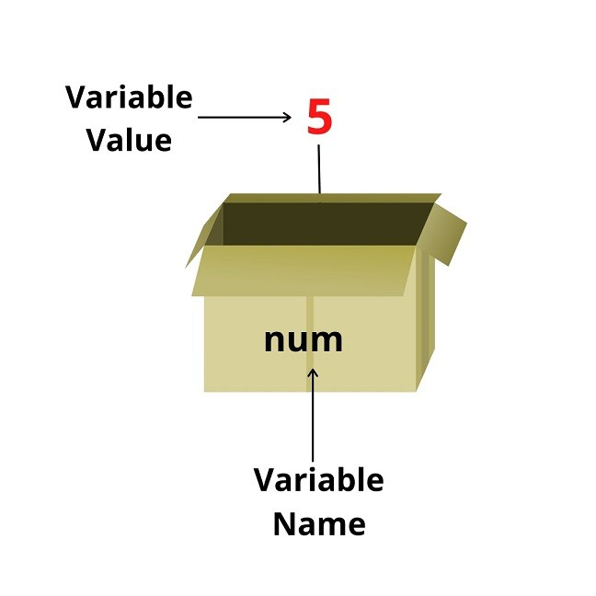

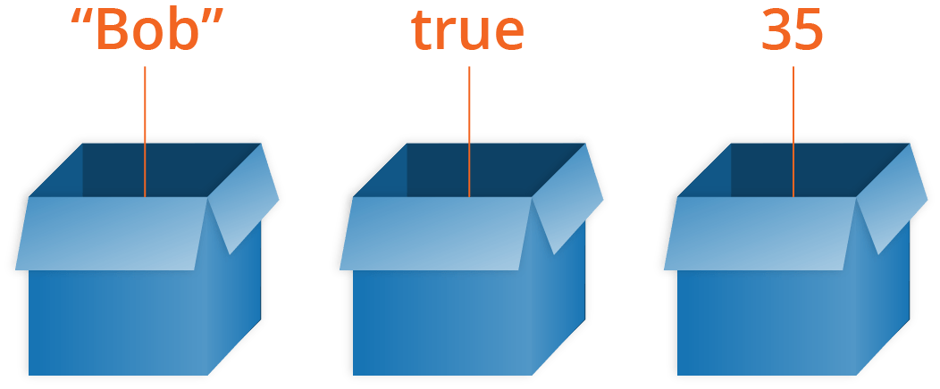
Variable Definition
Variables as the name suggest are anything whose values vary.
You can assume a variable as a container or box which is used to hold values.
A JavaScript variable is a name given to a memory location that is used to store values.
Memory is allocated to a variable used in the program and is given some name.

Slide 5
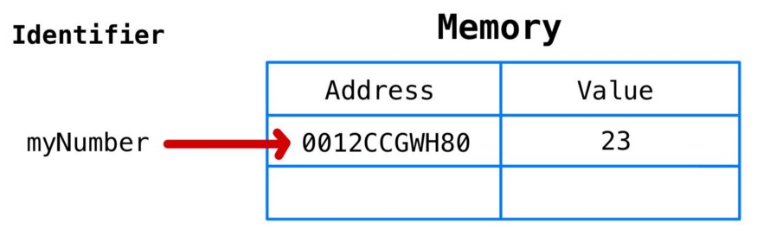
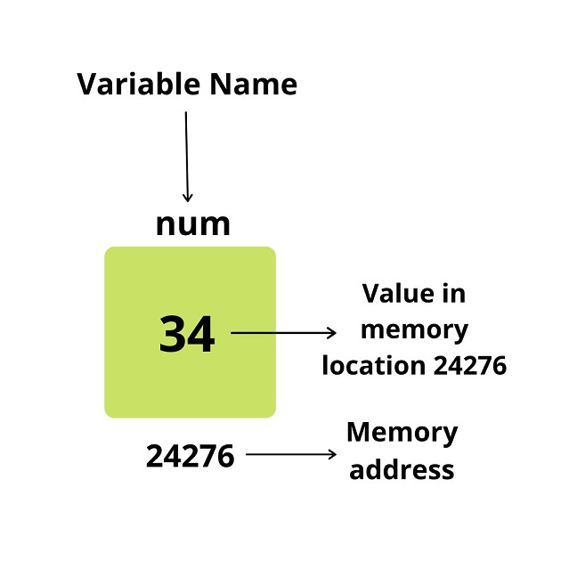
Variable Memory Allocation
Create a unique identifier for your variable (“myNumber”).
Allocate an address in memory (will be assigned at runtime).
Store a value at the address allocated (23).

Slide 6


Declaring Variable
var myName;
let myLastName;
const myAge;
Creating a variable in JavaScript is called "declaring" a variable.
You declare a JavaScript variable with the var, let or const keyword:
After the declaration, the variable has no value (technically it has the value of undefined).

Slide 7
Initialize (Assign) Variable
carName = "Volvo";
var carName = "Volvo";
To assign a value to the variable, use the equal sign:
You can also assign a value to the variable when you declare it:

Slide 8
Variable Naming Rules
A variable or identifier should begin with an underscore (_) symbol, a dollar ($) sign, or an alphabet (a-z or A-Z).
Numbers cannot begin the name of any variable
A variable name shouldn’t have any blank space or special character except the underscore (_) and dollar ($) sign.
A variable name or identifier cannot be a JavaScript reserved keyword.
Variable names are case sensitive
Variable Name(Identifier) | Valid/Invalid
_num | valid
123abc | invalid
$name | valid
%age | invalid
name123 | valid
abc^ | invalid

Slide 9
2
2
2
Variable
Scope

Slide 10
Variable Scope
Storing values in variables is a fundamental concept in programming. A variable’s “scope” determines when it is and isn’t available throughout your program.
Understanding variable scope in JavaScript is one of the keys to building a solid foundation in the language.
Variable Scope
Global Scope
Local Scope
Block Scope
Function Scope

Slide 11
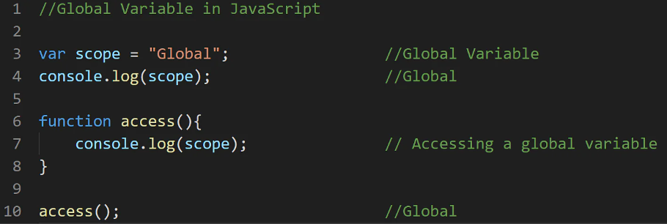
Global Scope
Any variable declared outside of a function is said to have Global Scope.
In simple terms, a variable that can be accessed anywhere in the program is known as a variable with global scope. Globally scoped variables can be defined using any of the three keywords: let, const, and var.

Slide 12
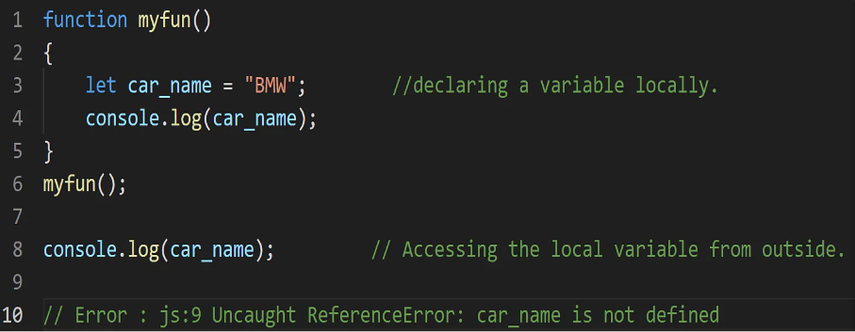
Local Scope
Any variable that you declare inside a function is said to have Local Scope. You can access a local variable can within a function. If you try to access any variable defined inside a function from outside or another function, it throws an error.

Slide 13
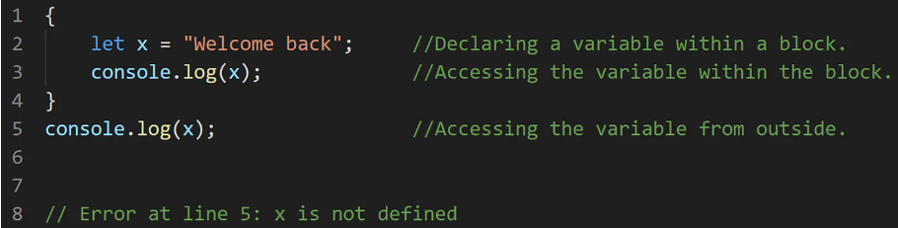
Block Scope
Before introducing ES6 (ECMAScript 6) in 2015, JavaScript had only two types of scopes: Global Scope and Local Scope.
A block is a chunk of code bounded by {}. A block lives in curly braces. Anything within curly braces is a block.
With the introduction of let and const keywords, it added a new type of Scope in JavaScript. You cannot access the variables declared inside a particular block (represented by {}) from outside the block.

Slide 14
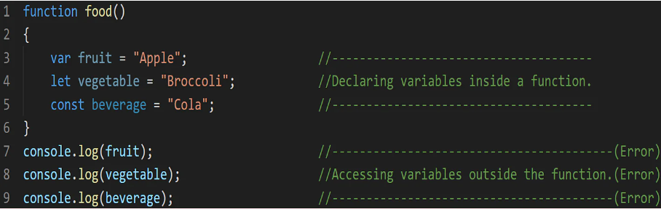
Function Scope
With the creation of each new function, it creates a new scope in JavaScript. You cannot access variables defined inside a function from outside the function or from another function. Var, let, and const work similarly when used inside a function.

Slide 15
3
3
3
Variable Declaration

Slide 16
Variable Declare Ways
Using var
var name = “John”
Using let
let carName = “Toyota”
Using const
const age = 22
Using nothing
color = “Blue”

Slide 17
Var Keyword
In JavaScript, var is a reserved keyword which is followed by a reference variable name. The name defined after the keyword can then be used as a pointer to the data in-memory.
Using var is the oldest method of variable declaration in JavaScript. Let's declare a variable and initialize it by assigning a value to it using the assignment operator (=):
// Declaration
var name;
// Initialization
name = "John Doe";
// Declaration and initialization
var name = "John Doe";

Slide 18
Var Scope
var declarations are global scope or functional scope
var tester = "hey hi";
function newFunction() {
var hello = "hello";
}
console.log(hello); // error: hello is not defined

Slide 19
Var re-declare and update
Re-declare
var greeter = "hey hi";
Update
var greeter = "hey hi";
var greeter = "say Hello instead";
greeter = "say Hello instead";

Slide 20
Var - Problem
var greeter = "hey hi";
var times = 4;
if (times > 3) {
var greeter = "say Hello instead";
}
console.log(greeter) // "say Hello instead"
So, since times > 3 returns true, greeter is redefined to "say Hello instead". While this is not a problem if you knowingly want greeter to be redefined, it becomes a problem when you do not realize that a variable greeter has already been defined before.
If you have used greeter in other parts of your code, you might be surprised at the output you might get. This will likely cause a lot of bugs in your code. This is why let and const are necessary.

Slide 21
Let Keyword
The let declaration was introduced with ES6 and has since become the preferred method for variable declaration. It is regarded as an improvement over var declarations and is block-scoped (variables that can be accessed only in the immediate block), circumventing the main issue that can arise with using var.

Slide 22
Let – Block Scope
A variable declared in a block with let is only available for use within that block:
let greeting = "say Hi";
let times = 4;
if (times > 3) {
let hello = “say Hello instead”； console.log(hello);// "say Hello instead"
}
console.log(hello) // hello is not defined
Using hello outside its block (the curly braces where it was defined) returns an error. This is because let variables are block scoped .

Slide 23
Let – Update but not Re-declare
Just like var, a variable declared with let can be updated within its scope. Unlike var, a let variable cannot be re-declared within its scope.
Update
let greeting = "say Hi";
Re-declare
let greeting = "say Hi";
greeting = "say Hello instead";
let greeting = "say Hello instead";
// error: Identifier 'greeting' has already been declared

Slide 24
Const Keyword
The const declaration was introduced with ES6, alongside let, and it is very similar to let. const points to data in memory that holds constant values, as the name implies. const reference variables cannot be reassigned to a different object in memory:

Slide 25
Const – Block Scope
The scope of a variable defined with the const keyword, like the scope of let declarations, is limited to the block defined by curly braces (a function or a block).

Slide 26
Const – Cannot be Updated or Re-declared
the value of a variable declared with const remains the same within its scope. It cannot be updated or re-declared.
const greeting = "say Hi"; greeting = "say Hello instead";
error: Assignment to constant variable.
const name = "John";
const name = "Jane";
Uncaught SyntaxError: Identifier 'name' has already been declared
Update
Re-declare

Slide 27
Comparison among var, let and const
var | let | const
Can be redeclared | Cannot be redeclared | Cannot be redeclared
Can be reassigned a value | Can be reassigned a value | Cannot reassign the value
Only have global and function scope | Can have a block scope | Can have a block scope
Variables are hoisted on top and can be used anywhere | Variables must be initialized before use | Variables must be initialized before use
Can be redeclared anywhere in the program | Can be redeclared inside a block | Can never be redeclared

Slide 28
Labo
Javascript Hero
JSchallenger

Slide 29
Project
Designing Static Website

Slide 30



Thank You

